Slide 1
DEA BENCHMARKING
Hospital Efficiency
Bader Al-Hilawani – 1009724498
Joyce Chen – 1003057577
Ella Wang –1003795592
Xiaotong Liu-1007578649

Slide 2
Background and Objective
It is important for a hospital to maintain a level of quality in its healthcare services and attain efficient production at the lowest possible cost.
Background
Objectives
Assessing the performance and efficiency of 37 hospitals in Ontario from various aspects (e.g. hospital size, ability, and purpose)
Which hospitals are efficient?
which hospital should be benchmarked?
Which metrics are useful for efficiency?
Research Questions

Slide 3
Model-Given Data
Given Data:
37 hospitals in Ontario
20 features
C-Section Rate data error excluded
Assumptions:
All other non-given resources are assumed to be equal or without shortage amongst the hospitals
20 Hospital Features
Teaching Emphasis | Cost per Patient-day | Surgical Cases | Death Rate
Cardiac Arrest Rate | Post-Surgery AMI Rate | Surgical Site Infections Rate | Sepsis Rate
C-Section Rate | Total Medical Inpatient Days | Medical ALC Days | Total Surgical Inpatient Days
Surgical ALC Days | Total Mental Health Inpatient Days | Mental Health ALC Days | Hip Fracture Cases
Hip Fracture Cases with Surgery in 24h | Median ED Delay (Hours) | Actual Cases with ED delay >= 2 Hours | Actual Cases with ED delay >=4 Hours
Notes:
For this project, we evaluated the efficiency of 37 hospitals using 20 different features as shown in the table. One data point was removed from the model due to an error in data collection. Hospital Q reported a C-Section Rate of over 108.5% which is impossible to achieve, thus the datapoint is removed from the model.
In creating the model, we made an important assumption that all other non-given features and resources are assumed to be equal or without shortage amongst the hospitals. For example, we assumed that there are enough doctors and nurses in each hospital.

Slide 4
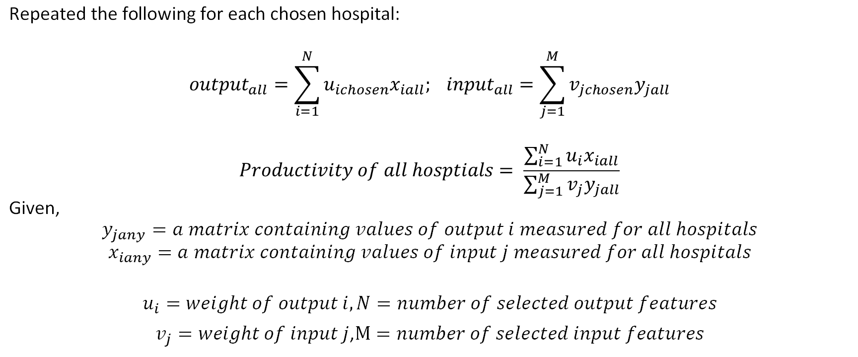
Model-Linear Model Setup
$$\text{Repeated} \text{the} \text{following} \text{for} \text{each} \text{chosen} \text{hospital}\text{:}$$
$${output}_{all}=\sum_{i=1}^{N}{u_{ichosen}x_{iall}; {input}_{all}=\sum_{j=1}^{M}{v_{jchosen}y_{jall}}}$$
$$Productivity of all hosptials= \frac{\sum_{i=1}^{N}{u_{i}x_{iall}}}{\sum_{j=1}^{M}{v_{j}y_{jall}}}$$
$$\text{Given}\text{, }$$
$$y_{jany}=a matrix containing values of output i measured for all hospitals$$
$$x_{iany}=a matrix containing values of input j measured for all hospitals$$
$$u_{i}=weight of output i, N=number of selected output features$$
$v_{j}=weight of input j$,$M=number of selected input features$
Notes:
In the mathematical model, Xiall represents a matrix containing values of output i measured for all hospitals , and Yjall a matrix containing values of input j measured for all hospitals. The weights ui and vj are the weights of output i and input j that give the maximum productivity of the chosen hospital. The output is calculated by summing the weighted output values, and the input is calculated by summing the weighted input values for each features. The productivity of all hospitals are then calculated as the ratio of outputs to inputs.

Slide 5
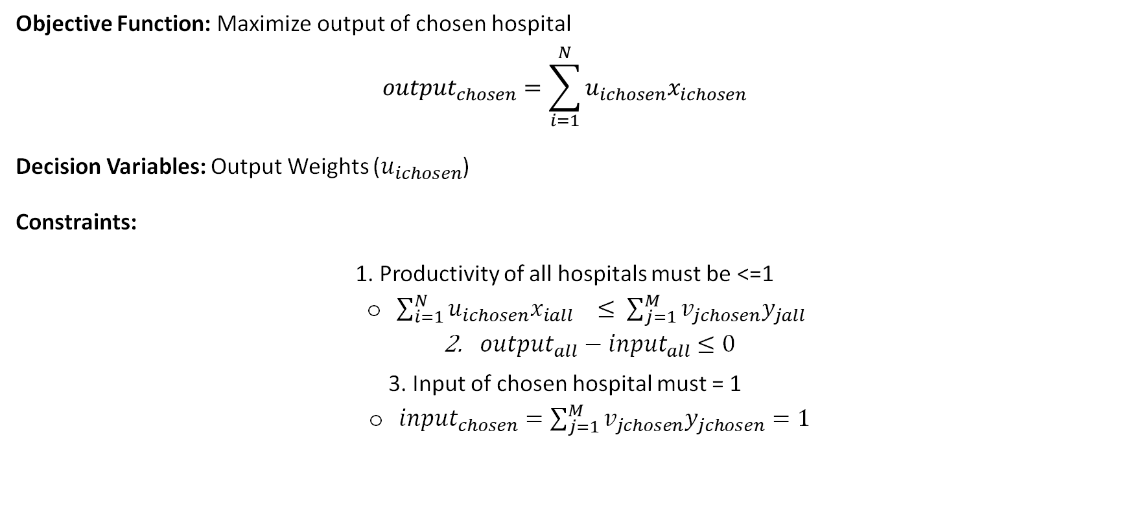
Model- Objective, Variables & Constraints
Objective Function: Maximize output of chosen hospital $${output}_{chosen}=\sum_{i=1}^{N}{u_{ichosen}x_{ichosen}}$$
Decision Variables: Output Weights ($u_{ichosen}$)
Constraints:
1. Productivity of all hospitals must be <=1
$\sum_{i=1}^{N}{u_{ichosen}x_{iall} ≤ \sum_{j=1}^{M}{v_{jchosen}y_{jall}}}$
${output}_{all}−$ ${input}_{all}$ $≤0$
3. Input of chosen hospital must = 1
${input}_{chosen}=\sum_{j=1}^{M}{v_{jchosen}y_{jchosen}=1}$
Notes:
The objective of the model is to maximize the output for each chosen hospital. A decision variable is a variable in a mathematical model that represents a quantity that a decision-maker can control or select to optimize a certain objective function, in this case, the individual output weight for each hospital is the decision variable.
Our model has three constraints. Firstly, the productivity of each hospital must be less than or equal to one, which means the sum of weighted output must not be greater than the sum of the weighted input of each hospital. Secondly, the differences between output and input of all hospitals must be less or equal to zero. thirdly, the input of each hospital must be equal to 1, which means the sum of weighted inputs for each feature is equal to 1.

Slide 6
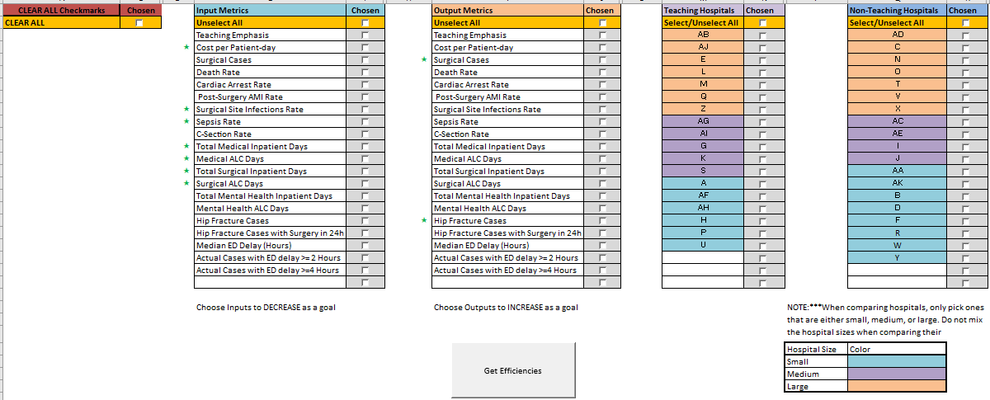

Methodology - User experience/thought process
Metrics placed into input/output categories
Hospitals are split into Teaching/Non-teaching Hospitals
Hospitals are split into Small, Medium, Large
Clear all selected metrics/hospital(s)
Outputs Efficiencies based on metrics & hospitals chosen

Slide 7
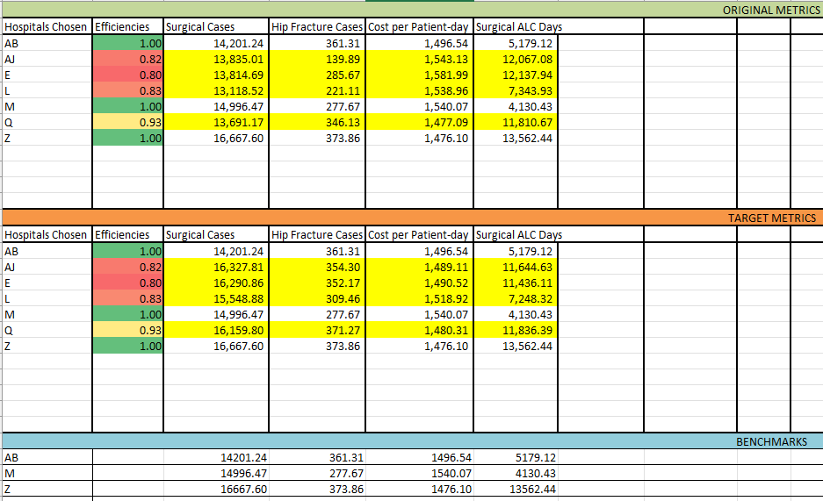
Methodology – cont - Target
User picks – Hospital Chosen/ Efficiencies/ Metrics Chosen
Target Metrics for Hospital Chosen
Benchmark – The Inefficient hospitals should be compared to.

Slide 8
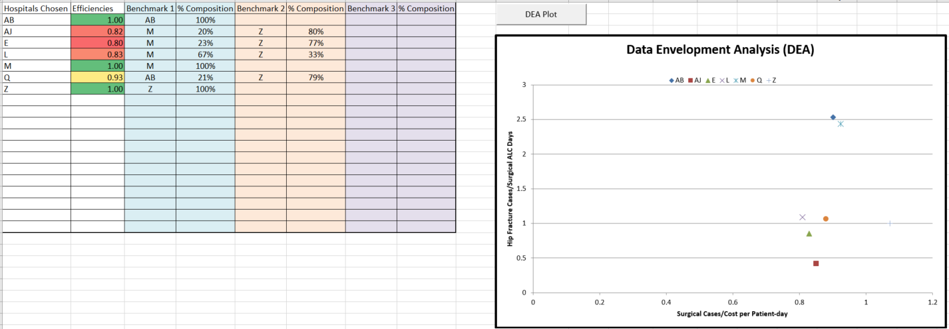
Methodology – cont - Result
DEA Graph is displayed based on Hospital & Metrics Chosen
User picks – Hospital Chosen/ Efficiencies/Benchmark Composition

Slide 9
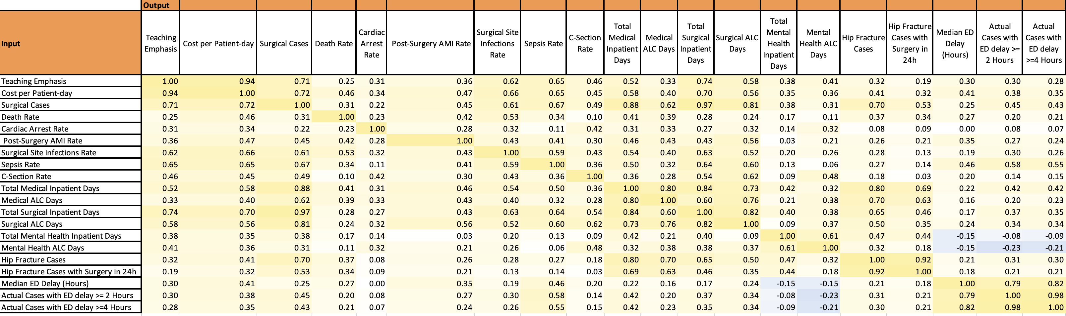
Which metrics are useful for efficiency : correlation analysis
Output variable selected
Input variable
selected
correlation
Highly correlated
Good indicators for distinguishing good efficiency from poor efficiency

Slide 10
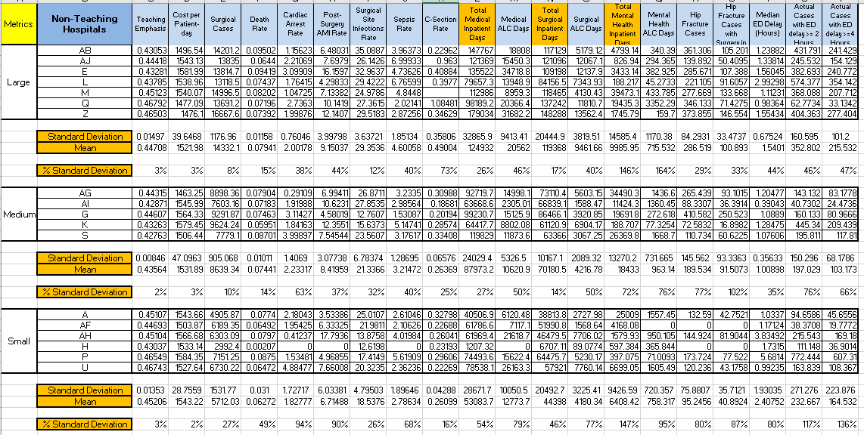
Which metrics are useful for efficiency : Statistical analysis
Hospital Size – Large
(%) Standard Deviation
Medium
Small

Slide 11
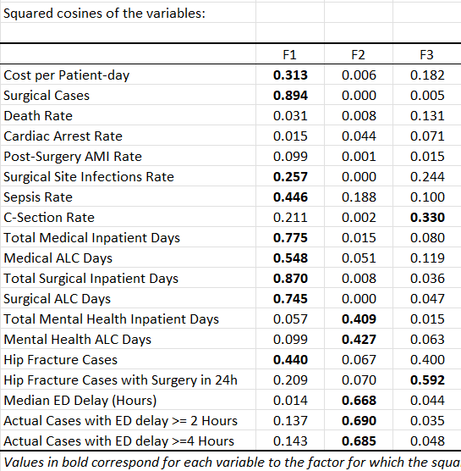
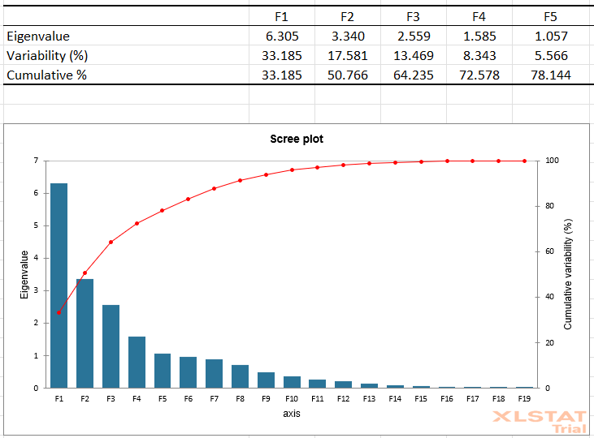
Which metrics are useful for efficiency : PCA analysis
Most variable metrics between hospitals are captured in the first group

Slide 12
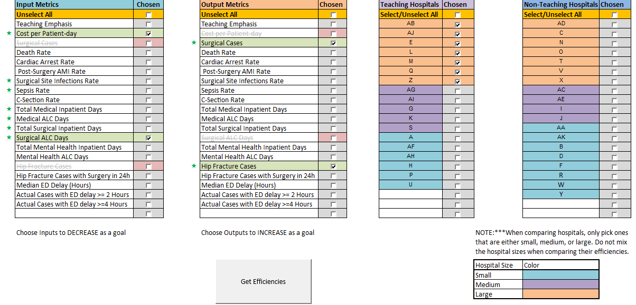
Results – Scenario 1 (Large + Teaching)

Slide 13
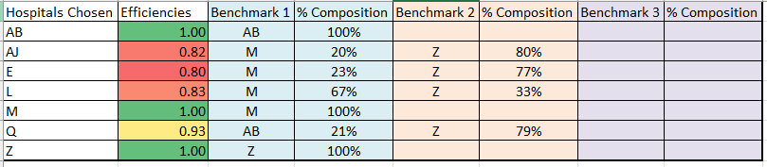
Results – Scenario 1 (Large + Teaching)
Hospitals AB, M and Z are efficient
Hospitals to benchmark
These represent composite hospitals that have higher output with the same input, or lower input with the same output
i.e. linear combination of efficient hospitals

Slide 14
Results – Scenario 1 (Large + Teaching)
How the hospital is performing now
(e.g. AJ has 140 hip cases)
How the hospital COULD be performing
(e.g. AJ’ can do 354 hip cases)

Slide 15
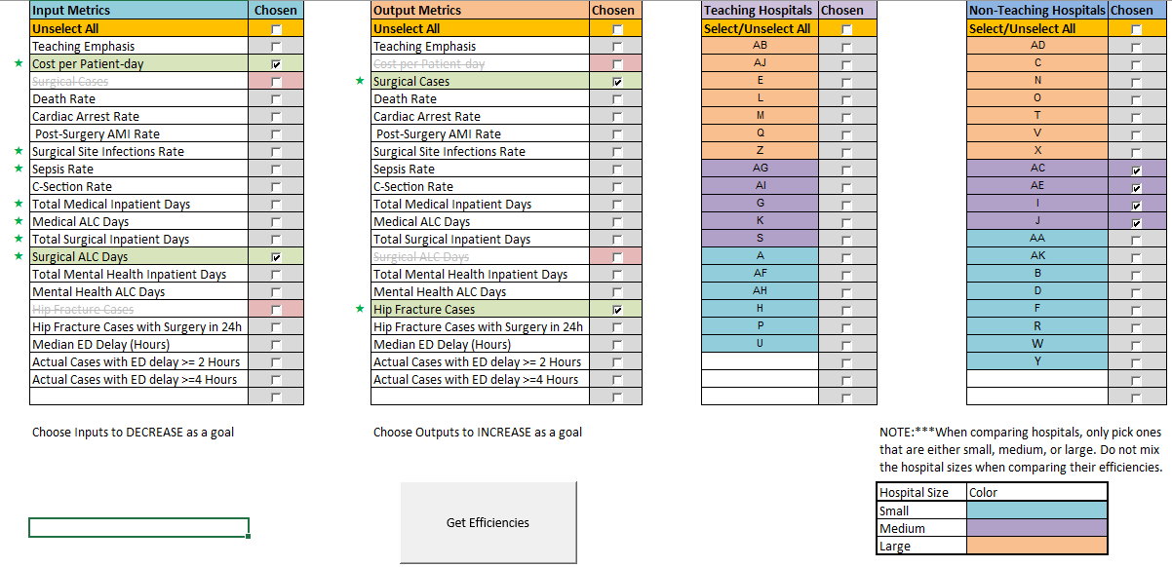
Results – Scenario 2 (Medium + Non Teaching)

Slide 16
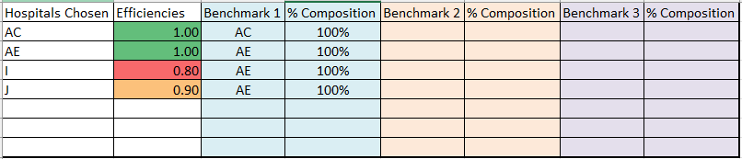
Results – Scenario 2 (Medium + Non Teaching)
Hospitals AC and AE are efficient
Both Hospitals use AE as benchmark

Slide 17
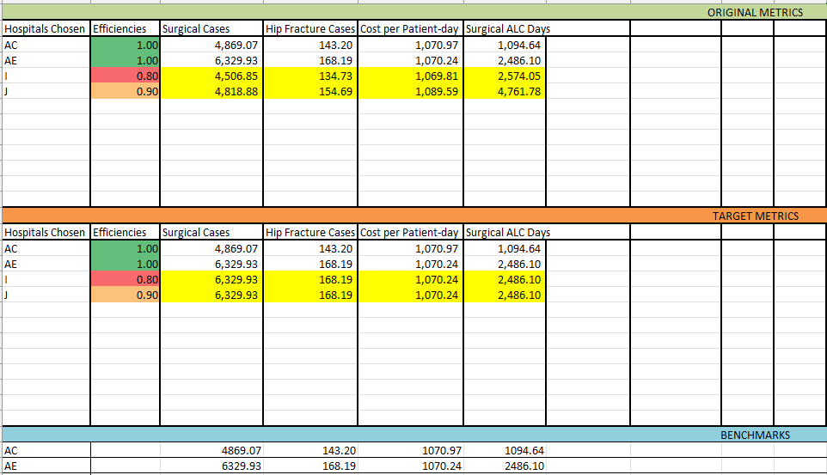
Results – Scenario 2 (Medium + Non Teaching)
Higher Volume of Cases, with lower ALC Days

Slide 18
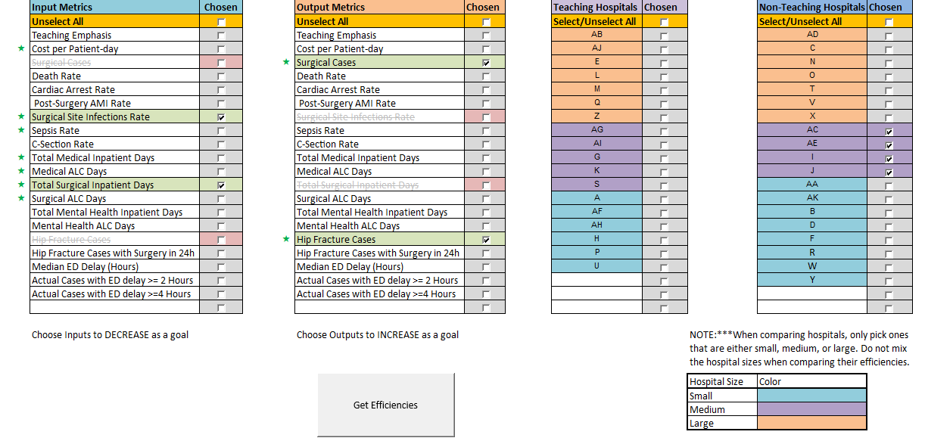
Results – Scenario 3 (Different Metrics)

Slide 19
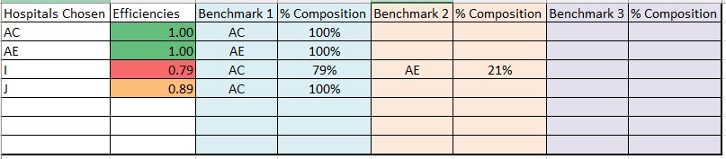
Results – Scenario 3 (Different Metrics)
Hospitals AC and AE are efficient
Hospital I uses AC and AE as benchmarks
Hospital J only uses AC as a benchmark

Slide 20
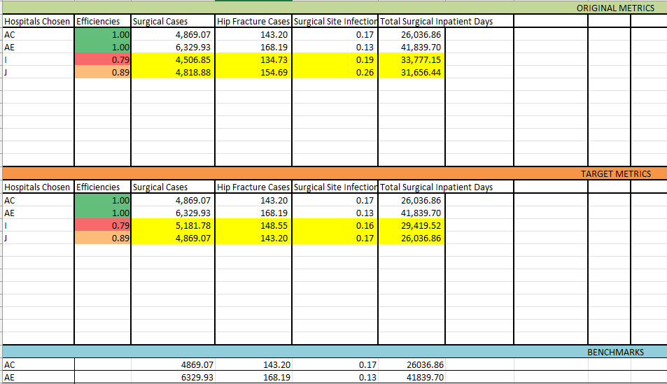
Results – Scenario 3 (Different Metrics)
J: Aim for higher Quality of Care by reducing Hip Fracture Cases slightly

Slide 21
DEMO

